Slide 1
SpaceNav & NexaGen
Ethan (BAN22597236), Matthew, Bhargav, Vatsal

Slide 2
Case Study selection
Ambiguities and Assumptions:
*finish this*
SpaceNav
Architecture Component's:
Satellite network, ground station, cloud infrastructure, and user devices
Data Element’s:
Positioning Data, Navigation Maps, Weather Data, Traffic Updates
Reason For Selecting The Case Study:
SpaceNav is a leader in satellite navigation, providing solutions that enhance accuracy across aviation, maritime, and land transportation
Risk Appetite:
SpaceNav has a high cyber risk appetite, willing to take calculated risks to raise innovation while balancing security considerations through informed planning

Slide 3
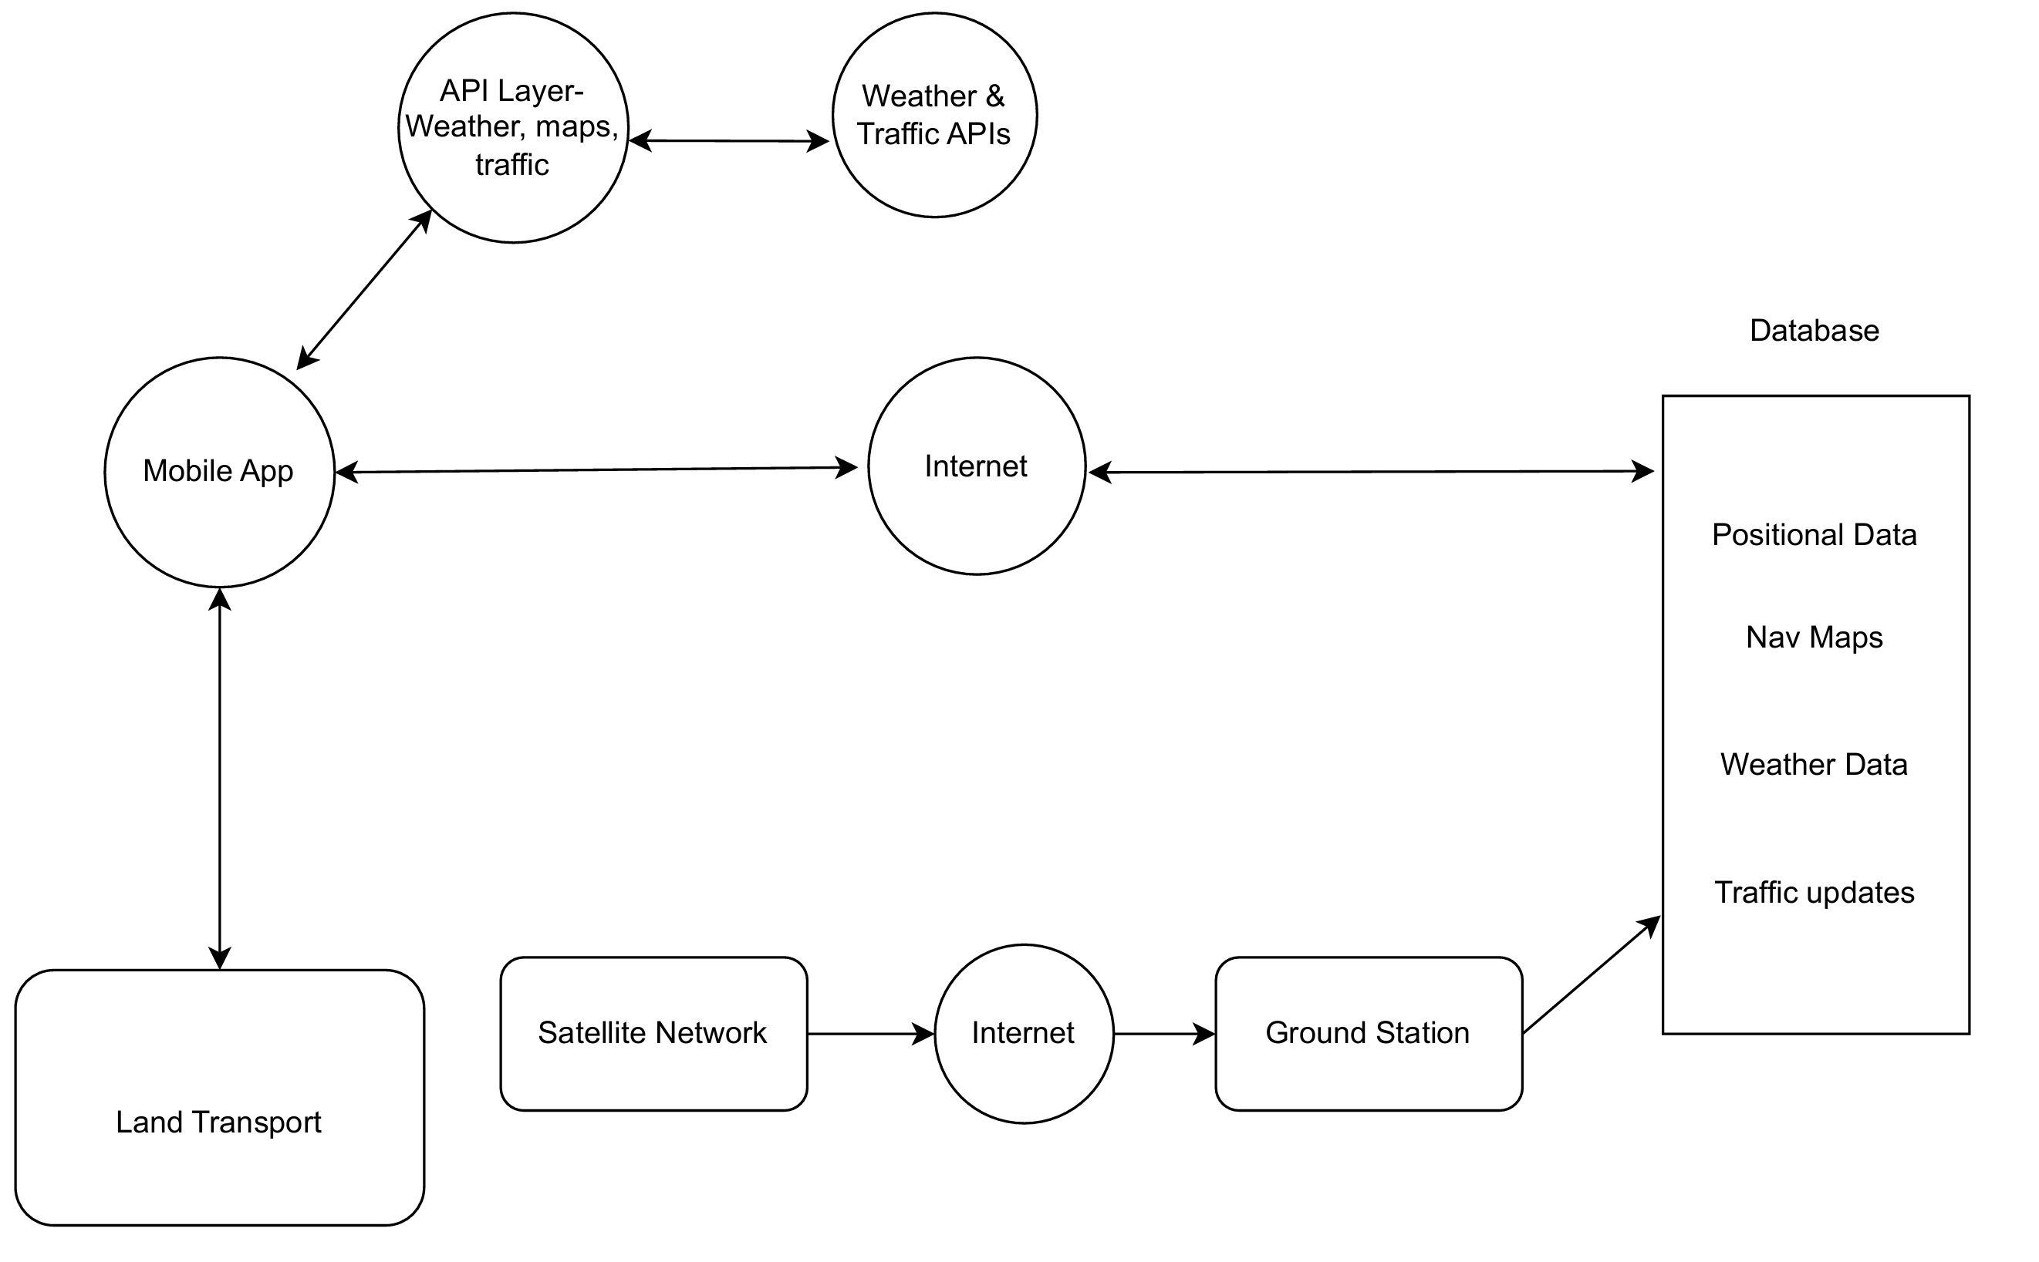
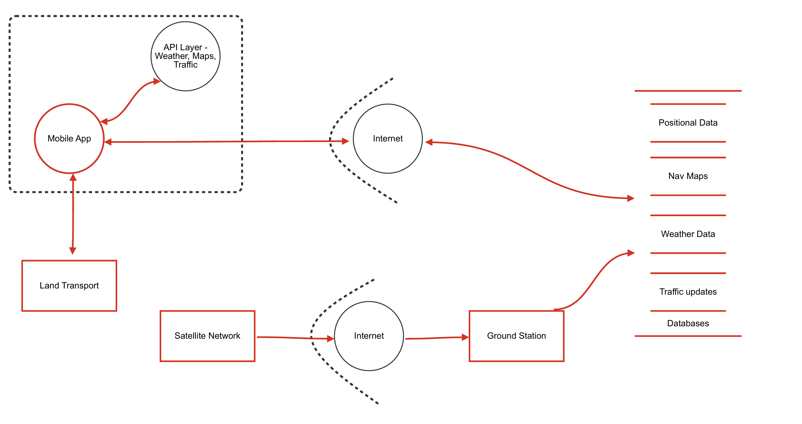
Threat Modelling
Architecture Diagram:
Threat Dragon Diagram:

Slide 4
Risk Treatment Plan
Risk Name | STRIDE Type | Priority | Score | Mitigations
Satellite Network | Repudiation | High | 8 | Implement comprehensive logging of all actions, transactions, and communications within the satellite network. Use digital signatures to verify the authenticity of messages, providing proof of origin and integrity
Ground Station | Spoofing | High | 7 | Implement strong authentication protocols, such as digital certificates and two-factor authentication, to verify the identity of users and devices accessing the ground station.
Mobile app | Elevation of privilege | Medium | 5 | Utilize strong authentication methods (e.g., multi-factor authentication) to ensure that only authorized users can access sensitive areas of the app.
Data flow (Satellite Network -> Internet) | Information Disclosure | High | 8 | Utilize secure communication protocols specifically designed for satellite communications to protect against vulnerabilities.
Data flow (Internet -> Ground Station) | Tampering | High | 8 | Use strong encryption (e.g., SSL/TLS) for data in transit between the internet and the ground station to protect against unauthorized modifications.
Data flow (Mobile app -> Internet) | Information Disclosure | High | 6 | Implement strict access controls and authentication for API endpoints to limit data access.

Slide 5
Software Development plan
We aim to secure our development environment by restricting access using 0 trust policies along with MFA
The tools we will use for development is docker for secure containers and OWASP ZAP for vulnerability scans
We aim to apply secure coding standards, threat modelling, automated security testing and design access controls around 0 trust
We will use role-based access control and securely store secrets with access logging
We will use automated dependency checking along with code audits to try catch vulnerabilities early
We will set up a response process with defined roles along with security patching protocols

Slide 6
OWASP SAMM
This link directs you to the OWASP SAMM development plan for SpaceNav
OWASP SAMM Toolkit v2.0.6

Slide 7
Security requirements pt1
Title / threat | Asset | Narrative | Work required | Verification criteria
Elevation of privilege | Protecting APIs | Attack gains higher access rights then intended allowing them to do unauthorized actions | Use cases: Privilege escalation detection – system monitors access requests Misuse cases: Unauthorized role access – user attempts to gain admin function without privileges | Privilege escalation testing to test if the system flags it and stops it from gaining privileges
Denial of service | Protecting data flow from internet to mobile app | Attack on a network by overwhelming it with traffic or requests that it breaks | Use cases: System load balancing – distribute system load to prevent overload Misuse cases: Overloading system resources – flood system with bogus requests disrupting it | Simulate a DoS attack and test system capabilities and measure recovery time
Information disclosure | Protecting data going between processes | Sensitive data gets exposed, such as personal information or system details | Use cases: Data encryption and secure storage – encrypt data to ensure it is safe in transit and storage Misuse cases: Data exposure through weak encryption – crack the weak encryption and read data | Ensure all data is encrypted uses AES 256 to keep it secure and test if the encryption works and is unreadable

Slide 8
Thank you
Mirjam Nilsson​
206-555-0146
mirjam@contoso.com
www.contoso.com

